Slide 1
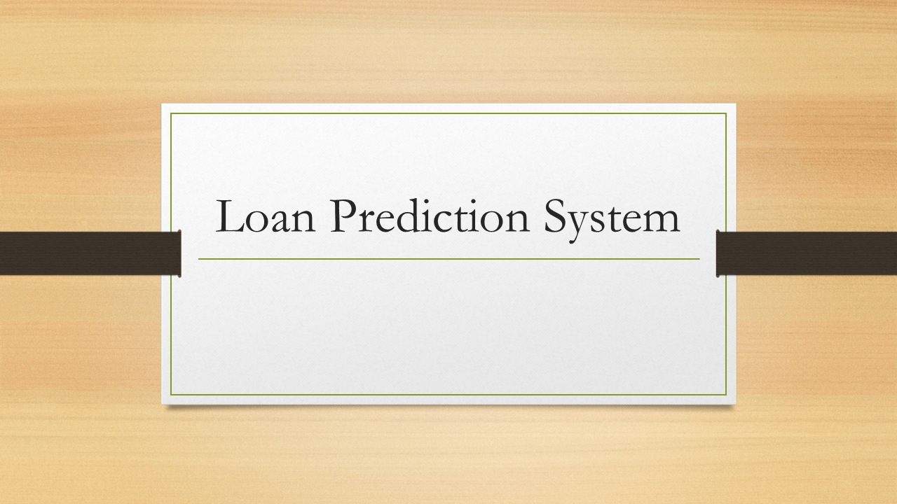
Loan Prediction System Using Machine Learning
Project Done By:
PARNAB MUKHERJEE

Slide 2
Objective
To develop a machine learning model for predict whether the person is eligible for loan or not.
Determine the creditworthiness of loan applicants to minimize default risk.
Develop a system that automates loan approval or rejection decisions based on data.
Streamline the loan approval process, making it faster and more efficient.
Enhance the customer experience by providing quick and accurate loan decisions.

Slide 3
Importance of project
Promotes access to credit for a wider range of individuals and businesses.
Reduces manual work and speeds up the loan approval process.
Employs data-driven models to make more accurate and consistent lending decisions.
Supports responsible lending practices, which can lead to sustainable business growth.

Slide 4
Problem Statement
Lending institutions face challenges in efficiently and accurately assessing the creditworthiness of loan applicants. The current manual underwriting processes are time-consuming, prone to human biases, and may lead to suboptimal lending decisions. Therefore, there is a need to develop an automated Loan Prediction System using Machine Learning to address the following issues:
Inefficient Loan Processing: The existing loan approval process is slow and resource-intensive, leading to delays in providing loans to eligible borrowers.
Risk of Default: Without accurate credit risk assessment, there is a higher risk of approving loans to borrowers who may default, resulting in financial losses for the lending institution.
Bias in Decision-Making: Human decision-makers may introduce biases based on factors such as gender, race, or age, which can lead to unfair lending practices.

Slide 5
Data Collection
Data Sources: Kaggle (https://www.kaggle.com/datasets/altruistdelhite04/loan-prediction-problem-dataset)
Data Preprocessing: Cleaning, handling missing values, Visualization

Slide 6
Model Development
Machine Learning Algorithm: Logistic Regression, Naive Byes, SVC, Random Forest, Decision Tree, K-Means.
Training and Testing: Splitting the data into 20-80 ratio for training and testing.
Model Evaluation: We used Accuracy Score to assess model performance.
Best Algorithm: After evaluating all the datasets, we found that “Logistic Regression” has the best accuracy score

Slide 7
Results
Visualization: After taking the inputs from the dataset, the results is:
Case 1 -
Actual Result: Loan Approved
Predicted Result : Congratulation! Your Loan Is Approved
Case 2 -
Actual Result: Loan Not Approved
Predicted Result : Sorry.. Loan Not Approved

Slide 8
Future work
GUI (Graphical User Interface)

Slide 9
Thank You

